Slide 1
Volt-VAR Optimization

Slide 2
Course Overview
Part 1: Traditional Voltage Control
Part 2: Detailed Load Modeling
Part 3: Volt-VAR Optimization

Slide 3
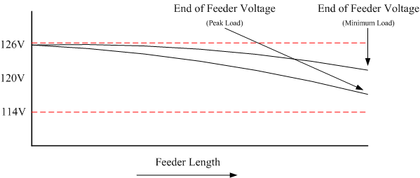
Part 1: Traditional Voltage Control
The voltage supplied to the customer is generally maintained within the limits set by ANCI C84.1, 120V +/-5%.
This is done by setting the voltage at the “head” of the feeder at the high end of the band, to ensure that the voltage drop at peak load does not exceed limits.

Slide 4
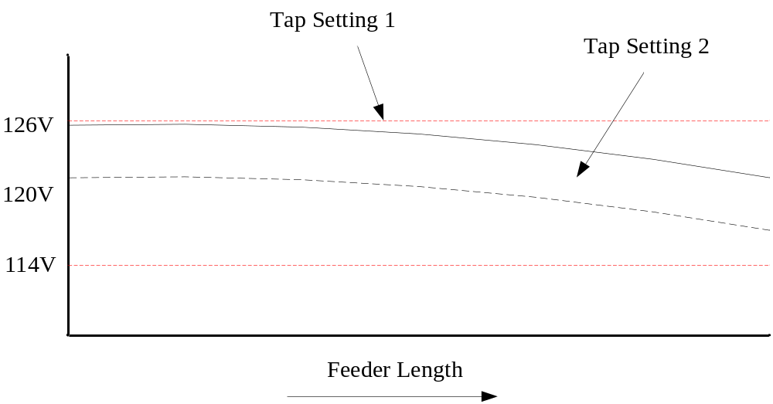
Traditional Voltage Control
(Regulators)
Regulators are often installed at the substation in order to adjust the voltage at the head of the feeder.

Slide 5
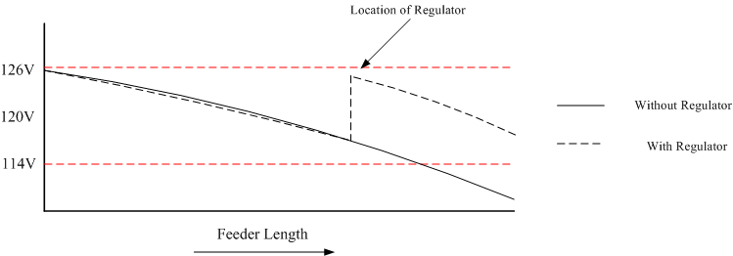
Traditional Voltage Control
(Regulators)
In extreme cases a down stream voltage regulator can be installed.

Slide 6
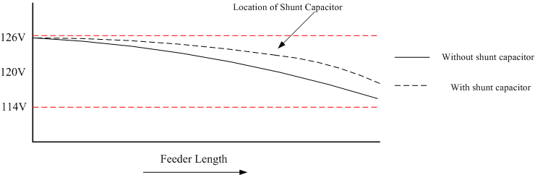
Traditional Voltage Control
(Capacitors)
If the feeder is heavily loaded then a shunt capacitor can be installed to raise the voltage.
This also reduces the reactive power needs of the feeder, reducing losses.

Slide 7
ANCI C84.1
American National Standards Institute (ANSI) C84.1 standard defines operating limits for distribution systems.
Range A (normal steady-state):114V-126V (RMS)
Range B(emergency steady-state):107V-127V (RMS)
<3% voltage unbalance at the utility meter

Slide 8
Operation of Voltage Control Devices
Voltage control devices, both regulators and shunt capacitors, traditionally have been operated in a stand alone mode.
Operation is achieved through manual operation, local set points, and on occasion remote measurements.
While the set points may be coordinated, it is a static coordination and does not account for time dependant variations in the system behavior.

Slide 9
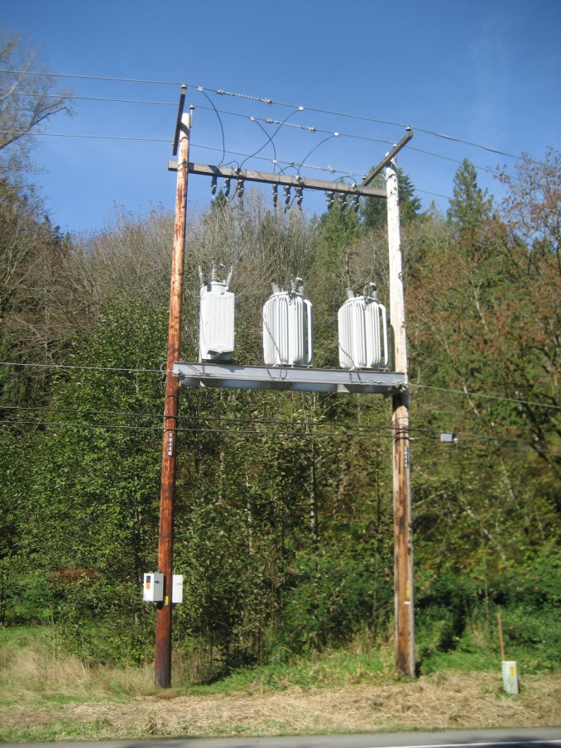
Voltage Regulators
Voltage regulators are used to adjust the voltage on a system in order to compensate for heavy loading which can result in a voltage drop.

Slide 10
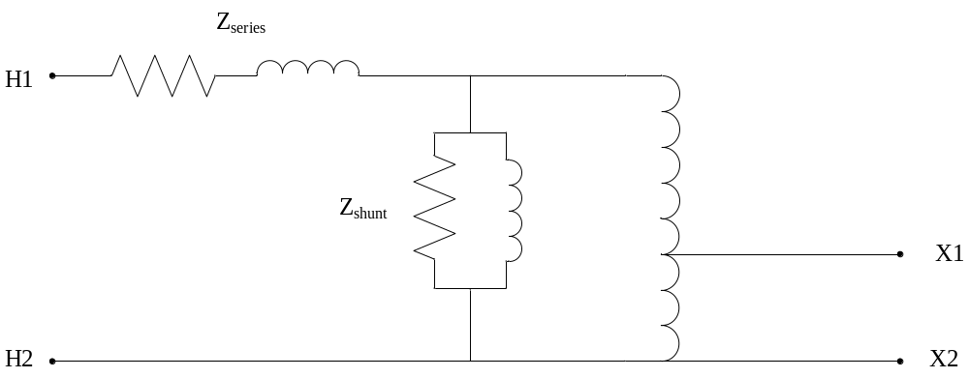
Voltage Regulators
Voltage regulators are variable tap position devices that change the effective turns ration of a single coil autotransformer.
A single coil means that the majority of power flows through copper, not an air gap. This results in a smaller device for a given power level.
In general, regulators have 32 tap positions that allow for a range of +/- 10% of nominal voltage.

Slide 11
Control of Voltage Regulators
Fixed: Not all feeders have voltage regulators, in which case there is no active regulation.
Output voltage: the taps are adjusted to regulated the voltage on the output of the regulator.
Remote voltage: the taps are adjusted to regulated the voltage on a remote node.
Line Drop Compensation (LDC): the taps are adjusted to regulate the voltage at a pseudo point in the system.

Slide 12
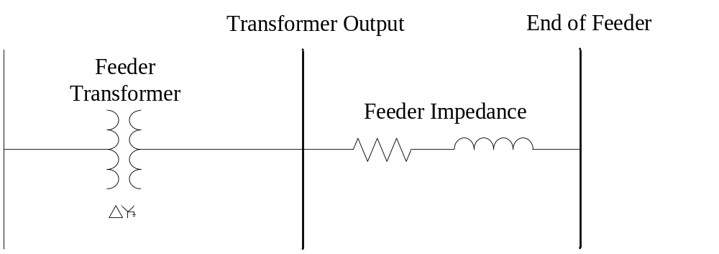
Fixed Voltage Control
For distribution feeders that are lightly loaded there may be no voltage control at the substation.
The voltage is determined by the transmission level voltage and the turns ration of the substation transformer.
This is a low cost method with no flexibility.

Slide 13
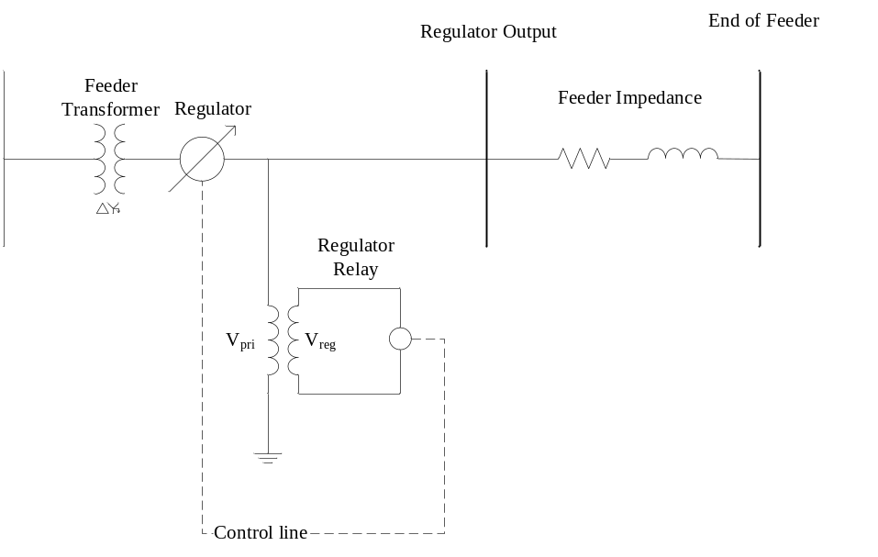
Output Voltage Control
A regulator is installed which will change the turns ratio of the transformer.
The taps are adjusted to regulate the voltage at the output of the regulator.
This is a very common method.

Slide 14
Output Voltage Control cont.
Object Code
Configuration Code
object regulator:650630 {
phases "ABCN";
from node:650;
to node:630;
configuration regulator_configuration:6506321;
}
object regulator_configuration:6506321 {
connect_type WYE_WYE;
band_center 2150.0;
band_width 80.0;
time_delay 0.0;
dwell_time 0.0;
raise_taps 16;
lower_taps 16;
regulation 0.10;
Control OUTPUT_VOLTAGE;
tap_pos_A 9;
tap_pos_B 7;
tap_pos_C 10;
}

Slide 15
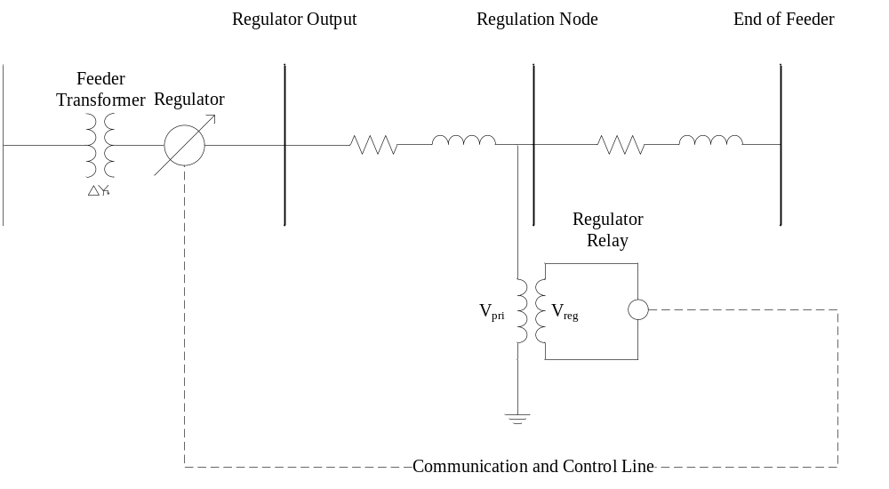
Remote Voltage Control
Output Voltage: A regulator is installed which will change the turns ratio of the transformer.
The taps are adjusted to regulate the voltage at the output of the regulator.
This method is uncommon and only used in special situations.

Slide 16
Remote Voltage Control cont.
Object Code
Configuration Code
object regulator:650630 {
phases "ABCN";
from node:650;
to node:630;
sense_node 671;
configuration regulator_configuration:6506321;
}
object regulator_configuration:6506321 {
connect_type WYE_WYE;
band_center 2150.0;
band_width 80.0;
time_delay 0.0;
dwell_time 0.0;
raise_taps 16;
lower_taps 16;
regulation 0.10;
Control REMOTE_NODE;
tap_pos_A 9;
tap_pos_B 7;
tap_pos_C 10;
}

Slide 17
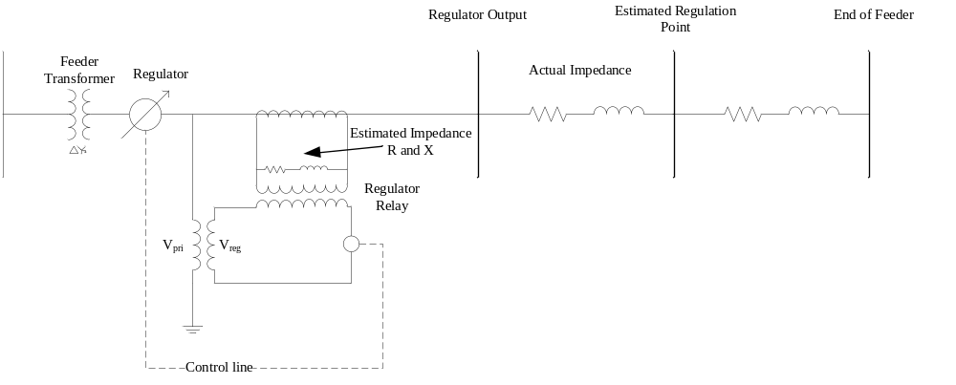
Line Drop Compensation
LDC regulators use an internal model in order to regulate the voltage at an “estimated” down stream point.
Since this point is only estimate, and the system impedance changes with time, this is not the most accurate method.
This is a mid-cost option that is utilized by utilities.

Slide 18
Control of Shunt Capacitors
Fixed: The capacitors are installed on a feeder and are continuously in operation.
Manual: A manually operated switch is used to place the capacitor in service.
Voltage : The operation of the capacitor is based on a local voltage measurement.
VAR: The operation of the capacitor is based on the a local measurement of the reactive power flowing on the line leading to the capacitor.
Volt – VAR: The operation of the capacitor is based on the a local measurement of the reactive power flowing on the line leading to the capacitor, plus there is a local voltage measurement to prevent over voltage conditions.

Slide 19
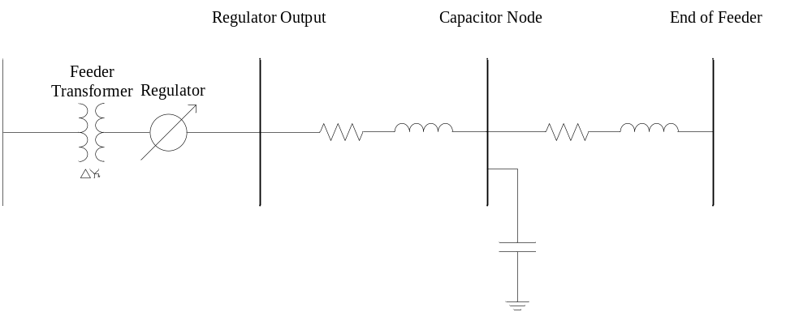
Fixed Capacitor Controls
For some feeders the voltage drop is large enough at all times that installation of capacitors are used.
These capacitors are installed and are always in service.

Slide 20
Fixed Capacitor Controls cont.
Object Code
object capacitor {
phases ABCN;
name CAP1;
parent 675;
phases_connected ABCN;
control MANUAL;
capacitor_A 0.200 MVAr;
capacitor_B 0.200 MVAr;
capacitor_C 0.200 MVAr;
control_level INDIVIDUAL;
time_delay 0.0;
dwell_time 0.0;
switchA CLOSED;
switchB CLOSED;
switchC CLOSED;
nominal_voltage 2401.7771;
Fixed capacitors can also be modeled as a ZIP load.
When modeled as a ZIP load:
  Z%= 1.00
  I%= 0.0
  P%= 0.0
  Z pf= 0.0
  I pf= 1.0
  P pf= 1.0

Slide 21
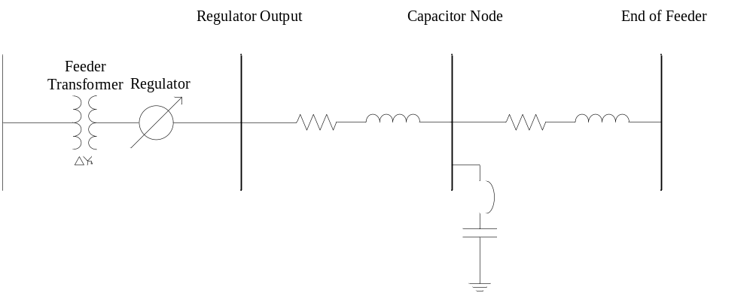
Manual Capacitor Controls
When there is enough voltage variability in a system it may be necessary to install a manual switch on a capacitor.
These switches are locally operated.

Slide 22
Manual Capacitor Controls cont.
Object Code
object capacitor {
phases ABCN;
name CAP1;
parent 675;
phases_connected ABCN;
control MANUAL;
capacitor_A 0.200 MVAr;
capacitor_B 0.200 MVAr;
capacitor_C 0.200 MVAr;
control_level INDIVIDUAL;
time_delay 0.0;
dwell_time 0.0;
switchA CLOSED;
switchB CLOSED;
switchC CLOSED;
nominal_voltage 2401.7771;
In fixed control the capacitor switches are always closed.
In manual control a player can be used to represent the manual operation of the capacitors.
For manual operation it is also necessary to state if the capacitor is operated by individual phase or banked.

Slide 23
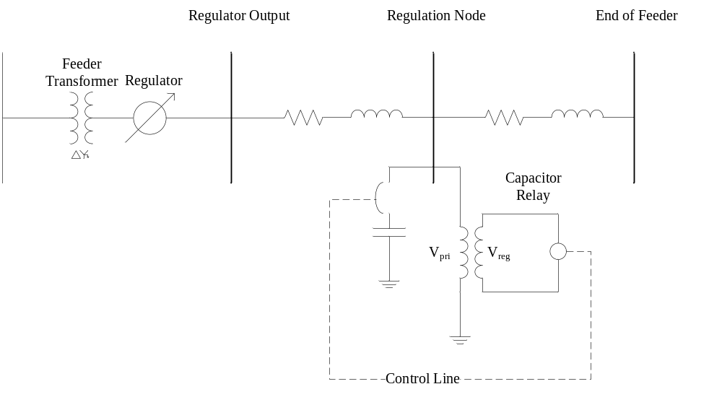
Voltage Based Capacitor Controls
The operation of the capacitor is based on a local voltage measurement.
When the local voltage magnitude drops below a set point then the capacitor is switched into operation.
When the local voltage magnitude increases above a set point then the capacitor is switched out of operation.

Slide 24
Voltage Based Capacitor Controls cont.
Object Code
object capacitor {
phases ABCN;
name CAP1;
pt_phase ABCN;
parent 675;
phases_connected ABCN;
control VOLT;
voltage_set_high 2100.0;
voltage_set_low 1950.0;
capacitor_A 0.200 MVAr;
capacitor_B 0.200 MVAr;
capacitor_C 0.200 MVAr;
control_level INDIVIDUAL;
time_delay 0.0;
dwell_time 0.0;
nominal_voltage 2401.7771;
A low voltage set point and a high voltage set point must be given.
Time delays must be specified.
A dead band must be appropriately set, too small of a dead band can lead to oscillations of the capacitor switches.
Excessive oscillations can lead to a catastrophic failure.
Oscillations without time delays will cause numeric instabilities in the simulation.

Slide 25
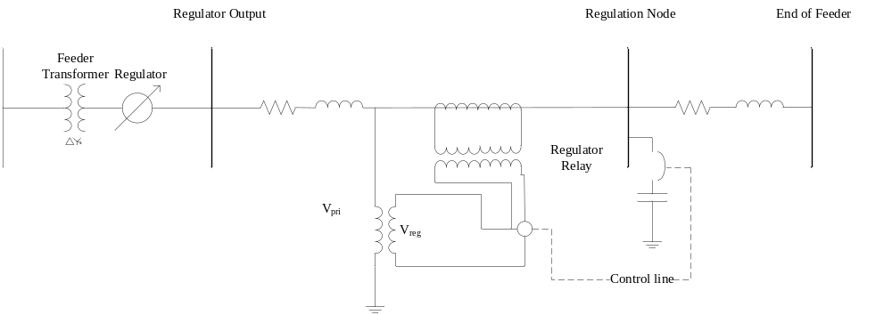
VAR Based Capacitor Controls
While shunt capacitors are sometimes used for voltage control, sometimes they are also used to control the flow of reactive power.
In this case, the flow of reactive power on the input line, and not the voltage, is the control value.

Slide 26
VAR Based Capacitor Controls cont.
Object Code
object capacitor {
parent R42247;
phases ABCN;
name CapBank1;
phases_connected ABCN;
control VAR;
capacitor_A 0.3 MVAr;
capacitor_B 0.3 MVAr;
capacitor_C 0.3 MVAr;
control_level INDIVIDUAL;
VAr_set_high 150kVAr;
VAr_set_low -225kVAr;
remote_sense_B Q16483_CAP;
nominal_voltage 7200.00
dwell_time 900;
time_delay 0;}
For VAR control the link leading to the node to which the capacitor is connected must be stated.
Then the high and low VAR values must be given.
A positive value indicates power is flowing into the stated link.
A negative value indicates power is flowing out of the stated link.
The issue of properly coordinated set points and capacitor size applies.

Slide 27
Volt-VAR Based Capacitor Controls
In Volt-VAR control the reactive power flowing on the input line is still the main control value.
But there is a voltage override which will then the capacitor off if the voltage is too high.

Slide 28
Volt-VAR Based Capacitor Controls cont.
Object Code
object capacitor {
parent R20185;
pt_phase ABC;
phases ABCN;
name CapBank2;
phases_connected ABCN;
control VARVOLT;
capacitor_A 0.3 MVAr;
capacitor_B 0.3 MVAr;
capacitor_C 0.3 MVAr;
control_level INDIVIDUAL;
voltage_set_high 7740;
voltage_set_low 7110;
VAr_set_high 150kVAr;
VAr_set_low -225kVAr;
remote_sense CAP_1;
remote_sense_B Q16642_CAP;
nominal_voltage 7199.558;
}
Volt as well as VAR values must be stated.
  Remote_sense
  Remote_sense_B
A lockout time is given to state how long a capacitor will be out of operation once an over voltage condition occurs.

Slide 29
Part 2: Detailed Load Modeling
The end use load accounts for 90-98% of the energy consumption of a distribution feeder.
In order to properly evaluate a Volt-VAR optimization it is necessary to have accurate voltage dependent models of the load.

Slide 30
Detailed End Use Load Models
Time-invariant load models (ZIP Models)
Time-variant load models
Physical load models
Multi-state physical load models

Slide 31
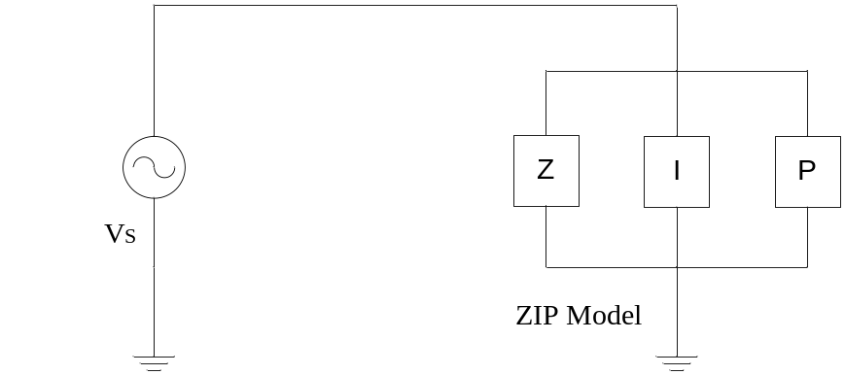
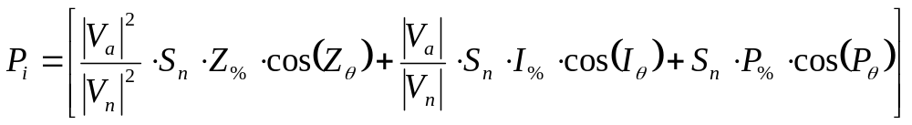
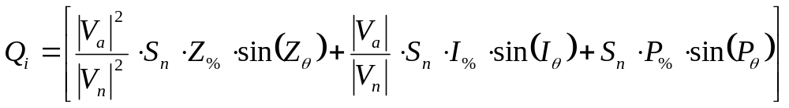

ZIP Load Model

Slide 32
ZIP Load Code
Object Code
Schedule Code
object ZIPload {
groupid plugload;
base_power plug1*2.828958; power_fraction 0.100000; impedance_fraction 0.800000; current_fraction 0.100000; power_pf 0.950000; current_pf 0.950000; impedance_pf 0.950000;
};
schedule plug1 { 0-23 0 * * * 0.1605;
24-59 0 * * * 0.1381;
0-30 1 * * * 0.1297;
31-59 1 * * * 0.1289;
0-34 2 * * * 0.1254;
35-59 2 * * * 0.1301;
0-29 3 * * * 0.1255;
30-59 3 * * * 0.1276;
0-18 4 * * * 0.1292;
19-44 4 * * * 0.1399;
45-59 4 * * * 0.1422;
0-14 5 * * * 0.1438;
15-35 5 * * * 0.1621;
36-59 5 * * * 0.1806;
0-14 6 * * * 0.1981;
…

Slide 33
Example ZIP Loads
Lighting
  Incandescent
  Compact Fluorescent (CFL)
  Light Emitting Diode (LED)
Televisions
  Cathode Ray Tube (CRT)
  Liquid Crystal Display (LCD).

Slide 34

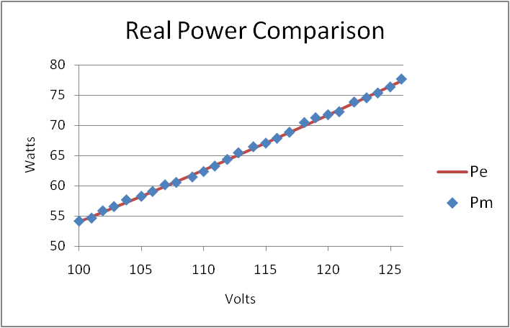
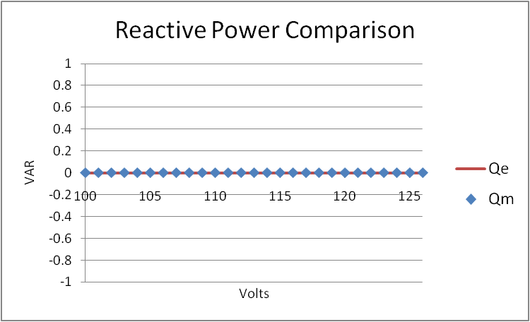
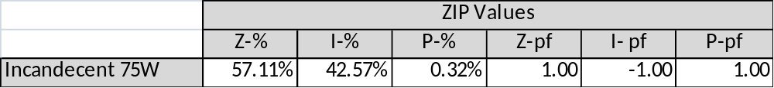
Incandescent Light Bulb

Slide 35

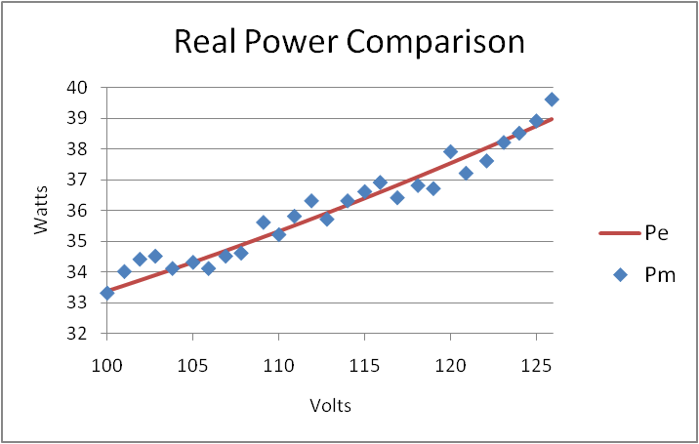
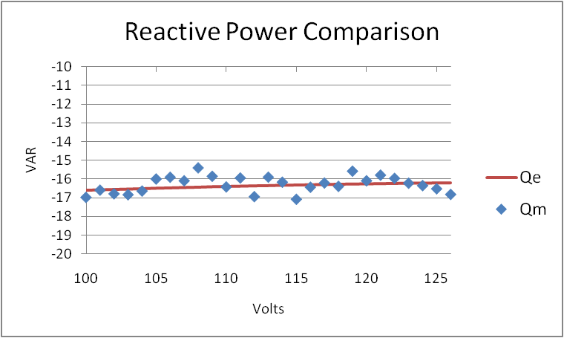
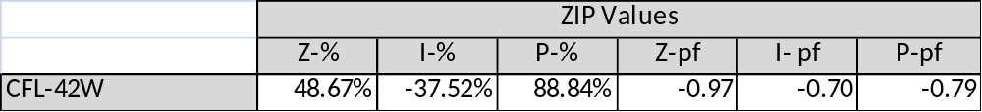
CFL Bulb

Slide 36
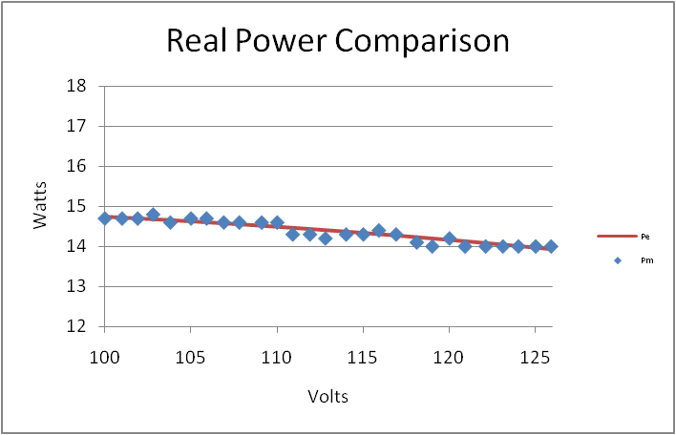
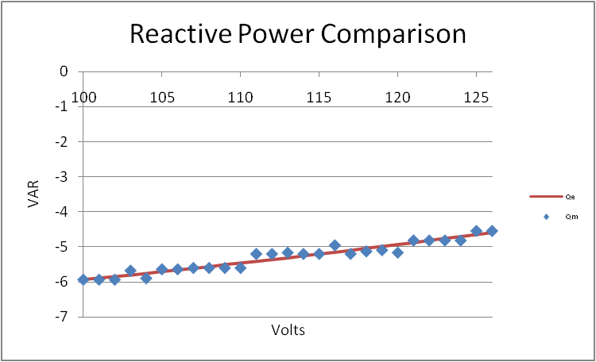
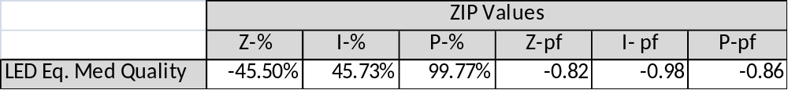
LED Bulb

Slide 37

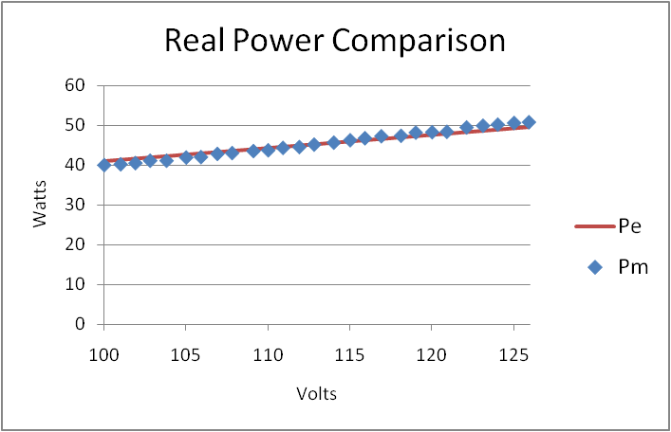
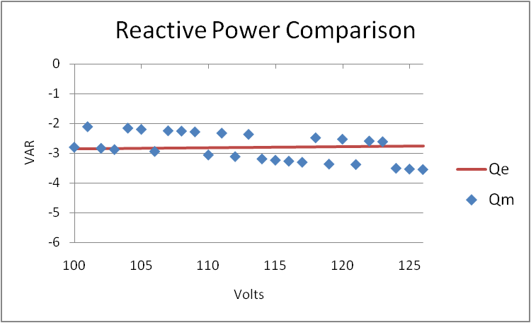
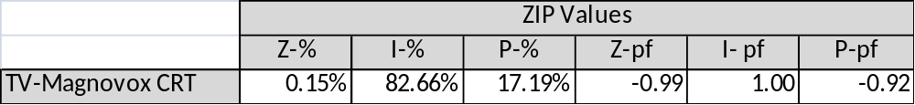
CRT

Slide 38

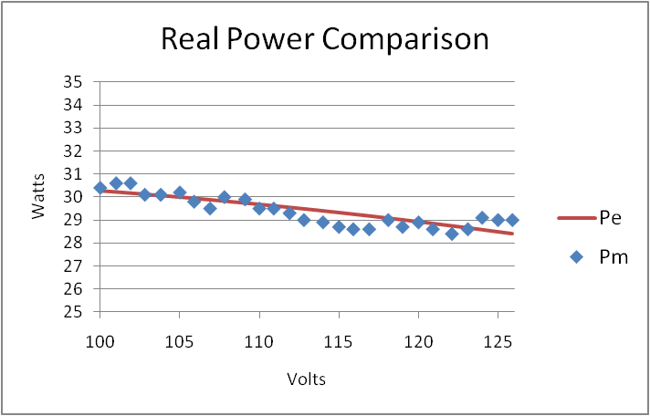
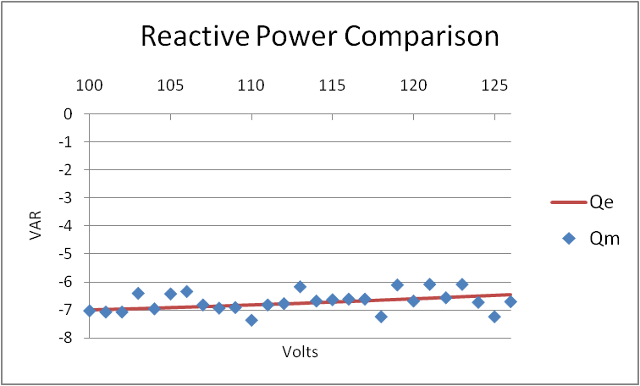
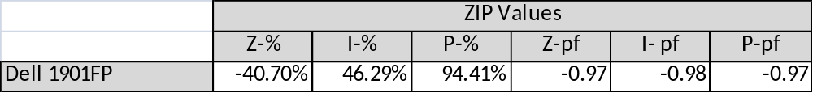
LCD

Slide 39
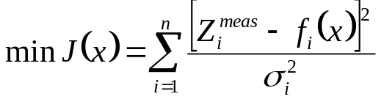




Weighted Least Squares Fit

Slide 40
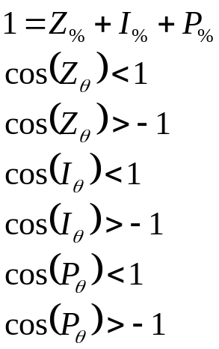
Constrained Weighted Least Squares Fit
Constraints

Slide 41

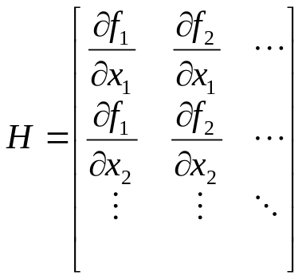

Weighted Least Squares Fit cont.
x^{est} is the value of x which gives the lowest value of J(x).
These are the ZIP values which best fit the measured data.

Slide 42
Time-variant load models
These are sometimes referred to as load profiles.
They can be fixed power values or time-variant ZIP models where ZIP coefficients change with time.
Often this information comes from measured data and is an aggregated value.

Slide 43
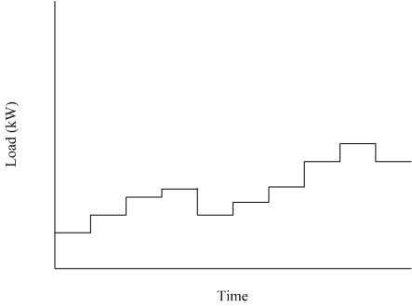
Example Load Profile

Slide 44
Physical Load Models
Physical load models are based on a physical process.
Processes can include: HVAC, energy storage, and thermal processes.
Time-variant in nature.
Can be significantly more complicated than ZIP models.
Provide the detail necessary to examine the actual behavior of end use loads.

Slide 45
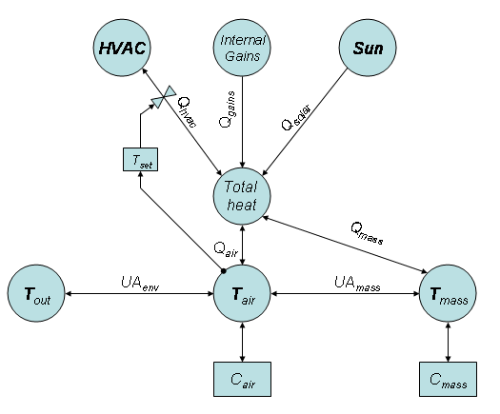
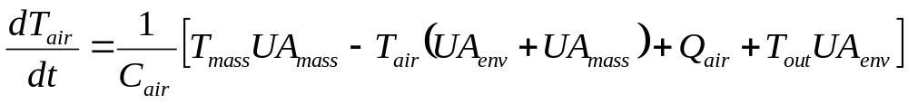
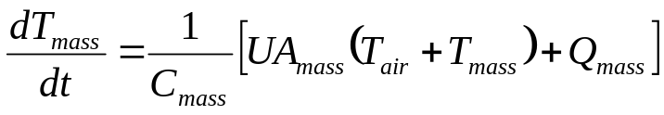
Physical Load Model – Residential HVAC System HVAC

Slide 46
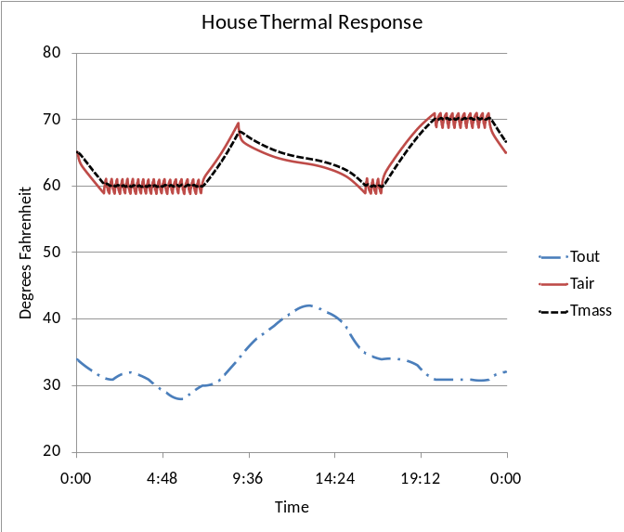
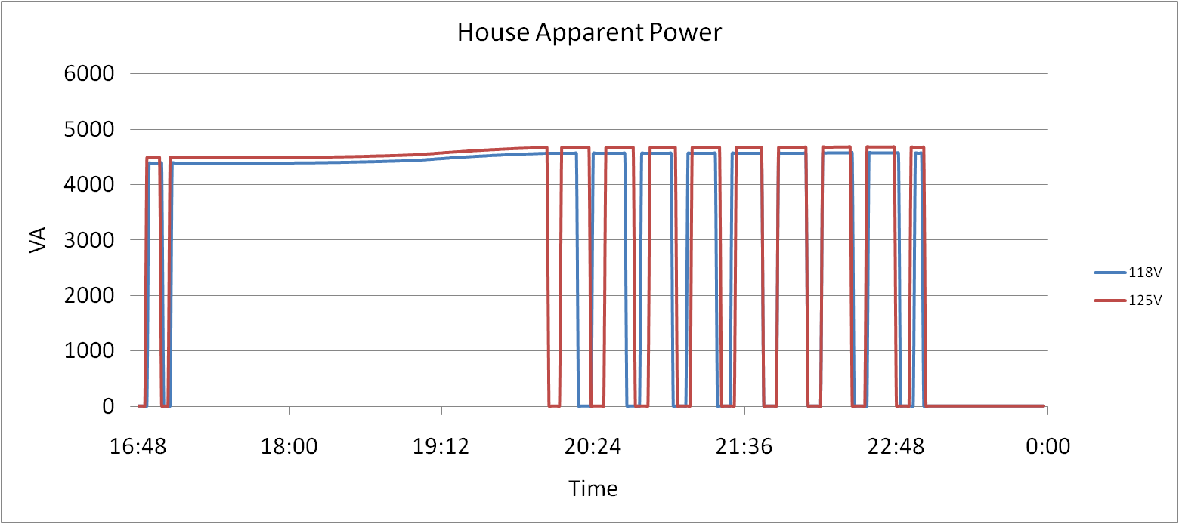
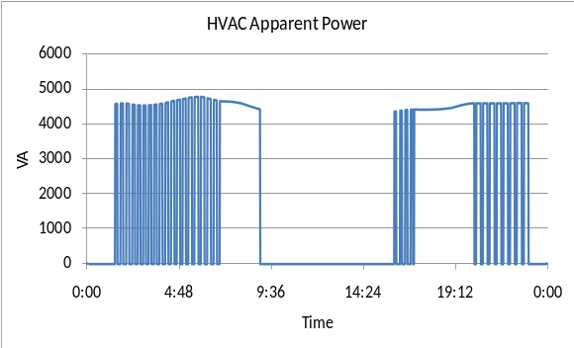
Physical Load Model – Residential HVAC

Slide 47
Multi-State Physical Load Models
Multi-state models as the name implies allow for more than one state of operation.
HVAC systems are a good example:
  State 1: Off
  State 2: Cooling
  State 3: Heating
  State 4: Auxiliary Heating
Multiple states of operation are necessary for complicated appliances and for the modeling of demand response signals.

Slide 48
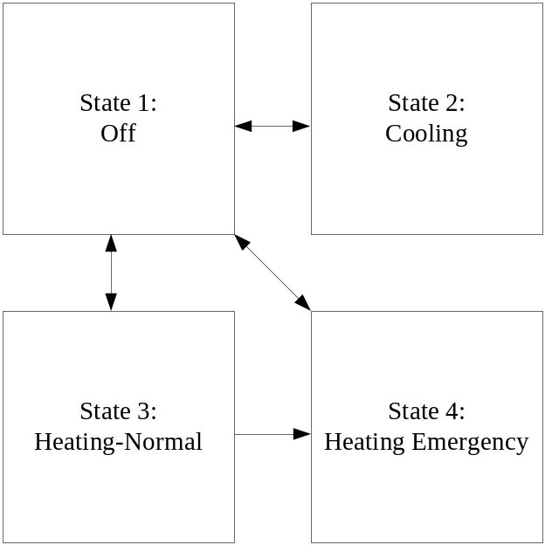
Multi-State Physical Load Models
From State | To State | Transition Rule
1 | 2 | T_{air} > (T_{high} + DB_{high})
1 | 3 | T_{air} < (T_{low} – DB_{low})
1 | 4 | T_{air} < (T_{low} – DB_{low}) & T_{out} < T_{aux}
2 | 1 | T_{air} < (T_{high} – DB_{high})
3 | 1 | T_{air} > (T_{low} + DB_{low})
3 | 4 | T_{out} < T_{aux}
4 | 1 | T_{air} > (T_{low} + DB_{low})

Slide 49
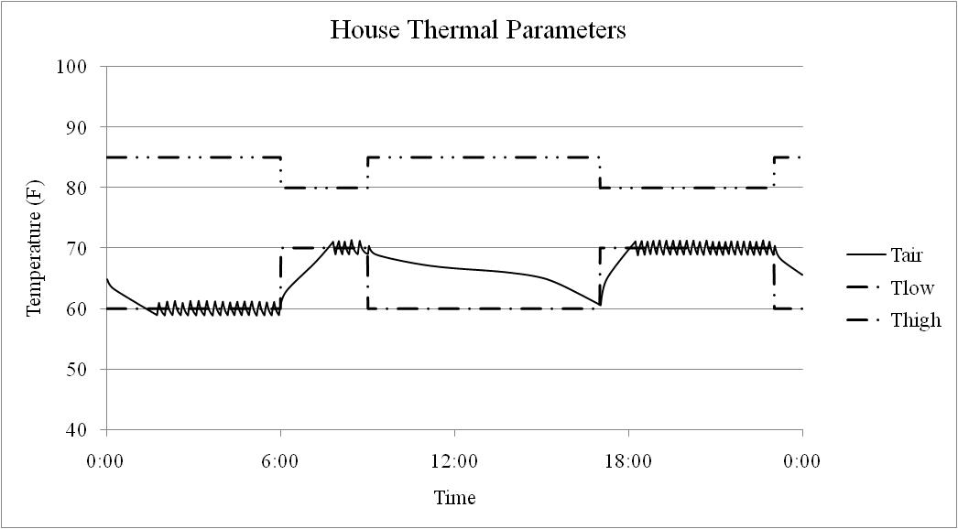
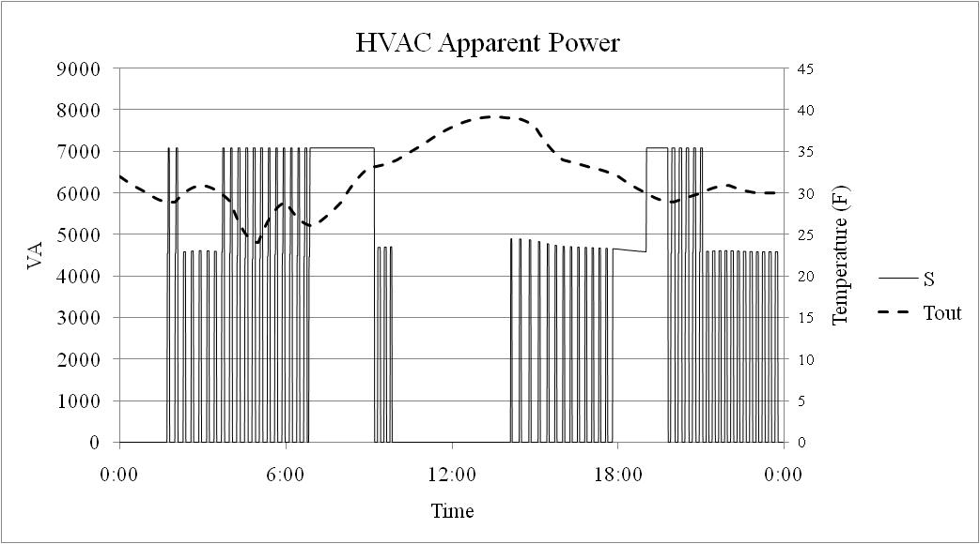
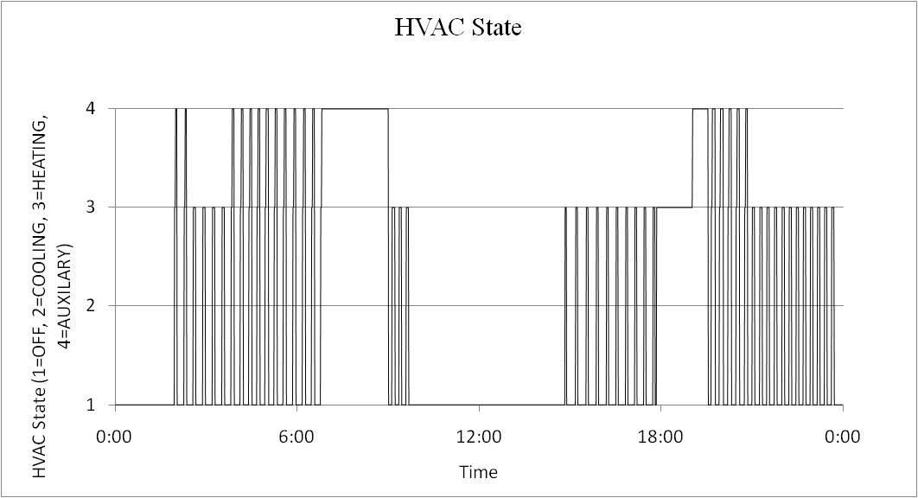
Multi-State Physical Load Models

Slide 50
Part 3: Volt-VAR Optimization
Volt-VAR Optimization exists in many forms.
The general principle is to control the voltage and reactive power on a distribution feeder so that load can be managed.
  Voltage optimization involves “flattening” the voltage profile and possibly lowering the level.
  VAR optimization involves controlling the flow of reactive power, which has an impact on voltage.

Slide 51
Volt-VAR Optimization
Voltage Reduction
  When lowering the voltage it is necessary to ensure that the voltage on all points of the system remain within specifications.
  The use of End Of Line (EOL) measurements can help to ensure that voltages at remote points are not too low.
  This is similar to operating a regulator in “REMOTE” except that there can be multiple measurement points.
VAR Optimization
  When capacitors operate based on local readings there is no regard for the rest of the system.
  VAR optimization allows capacitors to work in a coordinate manner to reduce overall reactive power flows, thus reducing system losses.

Slide 52
Volt-VAR Optimization cont.
There are numerous Volt-VAR optimization options commercially available:
  General: Electric Coordinated Volt-VAR Control
  Cooper: Integrated Volt VAR Control
  ABB: Volt VAR Optimization
  PCS UtiliData: AdaptiVolt
There are also numerous academic papers on the topic. We will examine the following method:
  “V. Borozan, M. Baran, and D. Novosel, “Integrated Volt/VAR Control in Distribution Systems”, IEEE PES Winter Meeting, 2001.”

Slide 53
Integrated Volt/VAR Control in Distribution Systems
This is an openly available Volt-VAR control system that has been implemented in GridLAB-D.
It is composed of 2 coordinated goals.
  Voltage reduction
  VAR control

Slide 54
Integrated Volt/VAR Control in Distribution Systems
Object Code
object volt_var_control {
name CVVC;
control_method ACTIVE;
capacitor_delay 60.0;
regulator_delay 60.0;
desired_pf 0.98;
d_max 0.8;
d_min 0.1;
substation_link “Reg1";
regulator_list “Reg1";
capacitor_list “CAP1,CAP2";
voltage_measurements “652,680";
maximum_voltages 3500;
minimum_voltages 2000;
max_vdrop 50;
high_load_deadband 30;
desired_voltages 2401;
low_load_deadband 30; }
Volt as well as VAR values must be stated.
  Remote_sense
  Remote_sense_B
A lockout time is given to state how long a capacitor will be out of operation once an over voltage condition occurs.

Slide 55
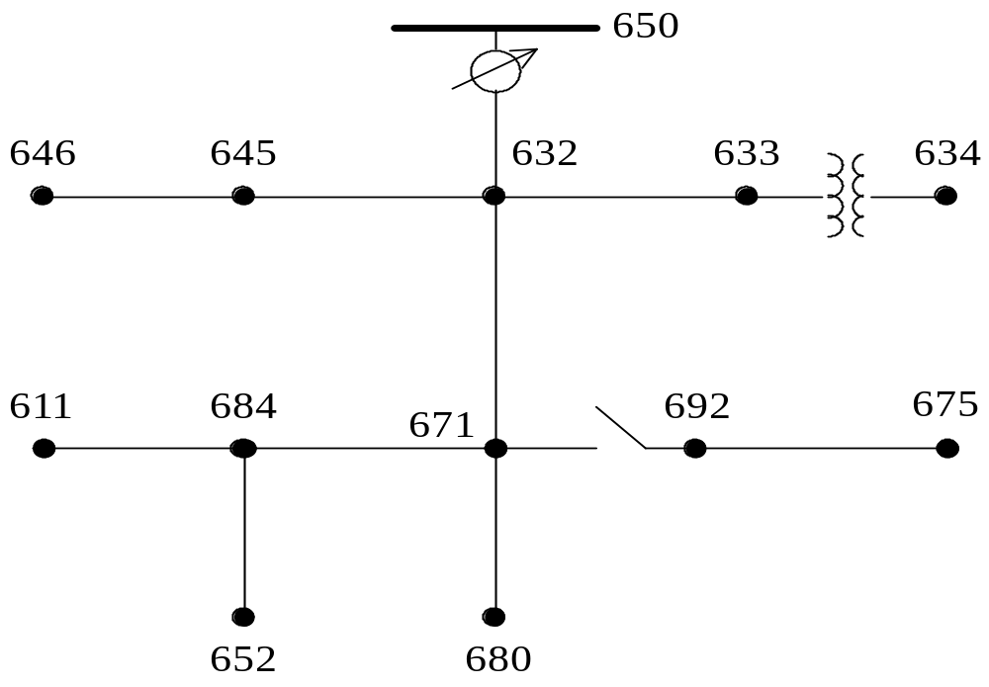
Modified IEEE 13 Node System with Volt-VAR Control
VAR Controlled Link
EOL Measurements

Slide 56
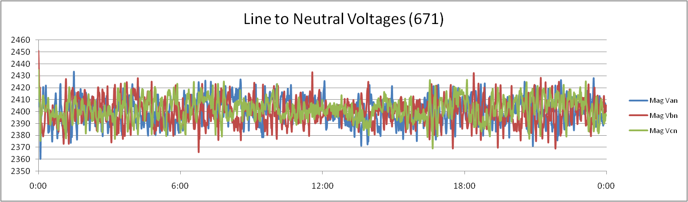
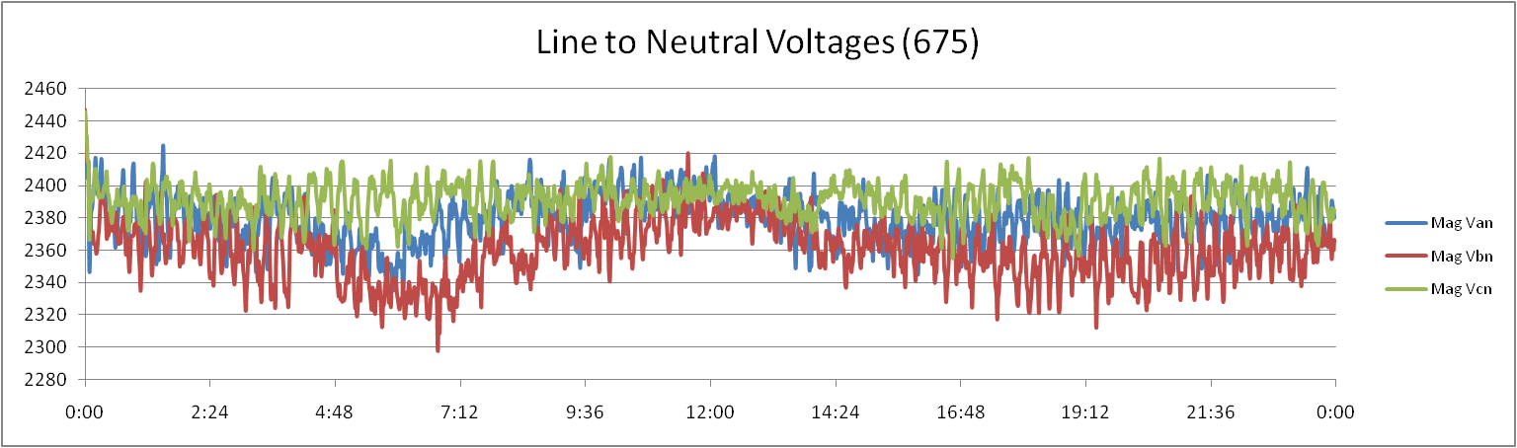
Case 1: Local Voltage Control
Voltage at node:671 is controlled by regulator to 2,400V:
Voltage at node:675 is maintained by capacitors:

Slide 57
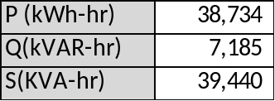

Case 1: Local Voltage Control cont.
Voltage is still operated at an upper level. As a result, there are energy reductions that are not realized.
Power factor is not maintained:

Slide 58



Case 2: Coordinated Volt/VAR Control
Voltage is regulated at remote nodes 652 and 680, to a values of 2,200V:
Energy consumption is reduced:
Power factor is maintained

Slide 59
Exercise 1
Using the model of a hot water heater, examine the energy consumption at various voltages.
The voltage can be changed by adjusting the output of the voltage regulator.

Slide 60
Exercise 2
Using the model of a ZIP Load, examine the energy consumption at various voltages.
The voltage can be changed by adjusting the output of the voltage regulator.

Slide 61
Exercise 3
Use the CVR 13 Node folder to determine the real and reactive energy consumption, as well as power factor for the following cases:
  CVR in STANDY
  CVR regulating to 2400
  CVR regulating to 2300
  CVR regulating to 2200
In your opinion, is the implemented CVR system effective? Explain.

